Slide 1
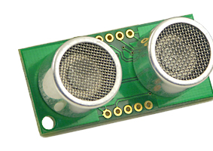
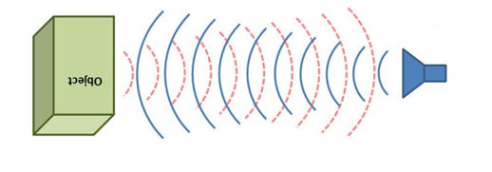
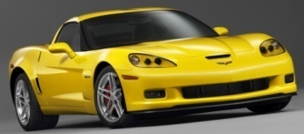
System Level overview
Obstacle Detection
Anticipation
Ultrasonic Sensor -SRF05
Obstacle
Distance

Slide 2
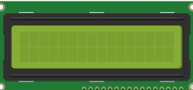
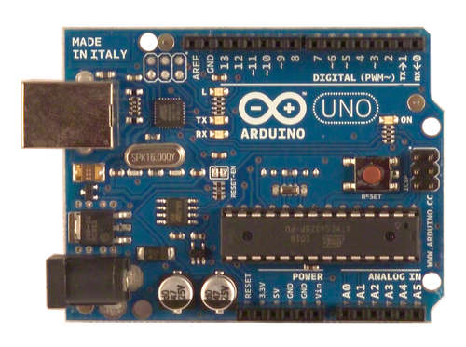
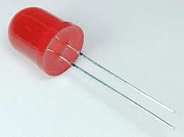
User Feedback
Output
Distance
Speed
Time
Arduino - ATmega328
LCD screen
Speed time calculation
Brightness ~ distance
LED

Slide 3
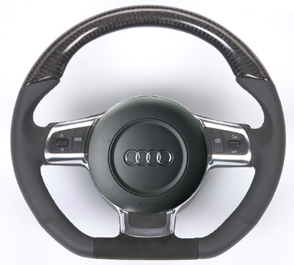
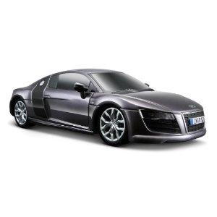
Automation
Vehicle Control
Arduino - ATmega328
User Vehicle
F
L
R
Speed time calculation
B

Slide 4

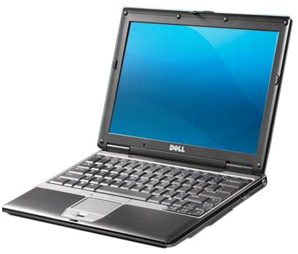
Automation - Input
Char
i
l
j
k
,
.
ASCI DEC
105
108
106
107
44
46
User Input
Computer output

Slide 5
Automation - Output
Action
Forward
Right
Left
Backward
Increase speed
Decrease speed
ASCI DEC
105
108
106
107
44
46
F
L
R
Hani insert pic of the arduino circuit
B

Slide 6

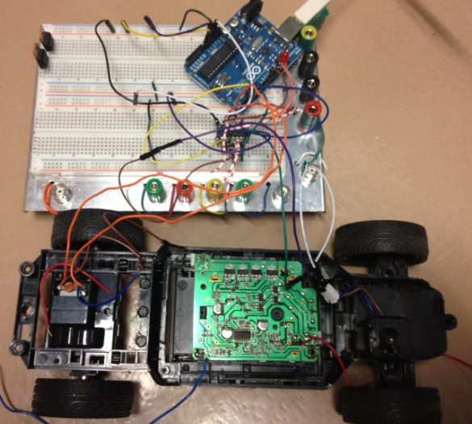
Automation
I received:
ASCI DEC
105
108
106
107
Speed Value: 200
Serial output from car

